Slide 1
The ERM Ecosystem: How it all fits together and where you fit in.
Region 1 Virtual Spring Meeting
Friday, April 28, 2023
Presented by: David Seibert,
Strategy, Risk, and Assurance Partner

Slide 2
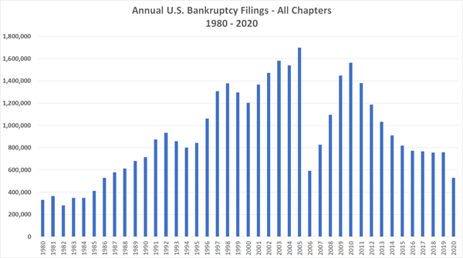
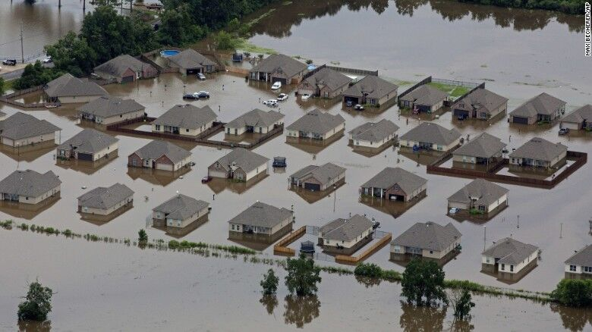
What is Risk? And what is Enterprise Risk Management?
Notes:
The word “Risk”, and the discipline of “Enterprise Risk Management” are very broad and ambiguous words and phrases. They conjure different thoughts in each of us.
Here are some “risks”. See the variability? SVB liquidity crisis to pandemic to floods to gross taco shells.

Slide 3
Question for the Group
What is the scope of Enterprise Risk Management?
Risk to achieving the strategic objectives
Risk to the safety and soundness of the credit union
Risk of non-compliance with regulation
Risk of critical failures in transactions and operations
All of the above

Slide 4
Question for the Group
How many risks are managed at your credit union?
About 25 risks
About 200 risks
Way more than 200 risks

Slide 5
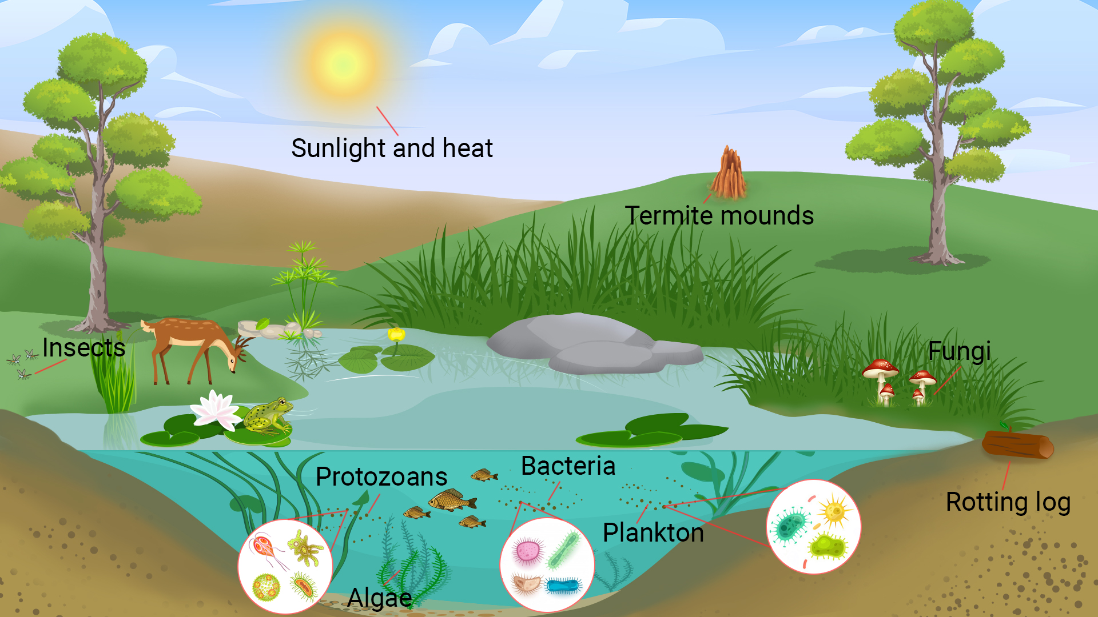
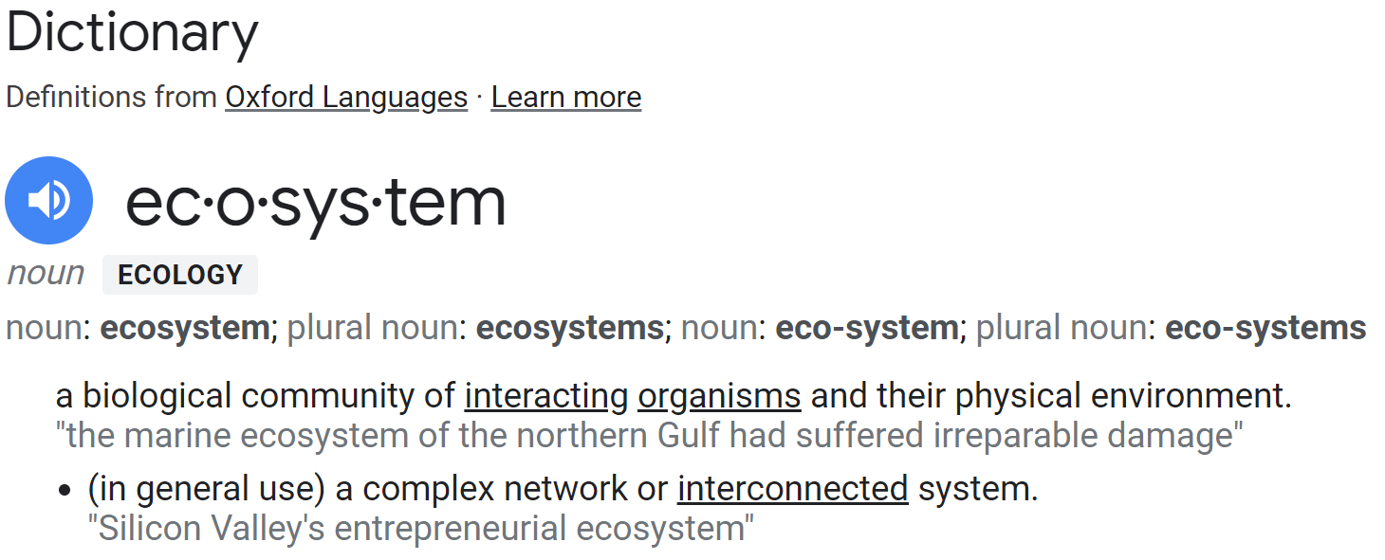
What is an Ecosystem?
Notes:
Recall that the topic today is the “ERM Ecosystem.”
What is an “Ecosystem?” Comes from the word “Ecology” and is used to describe a biological community.
But we are interested in the general use definition: A complex network or interconnected system.

Slide 6
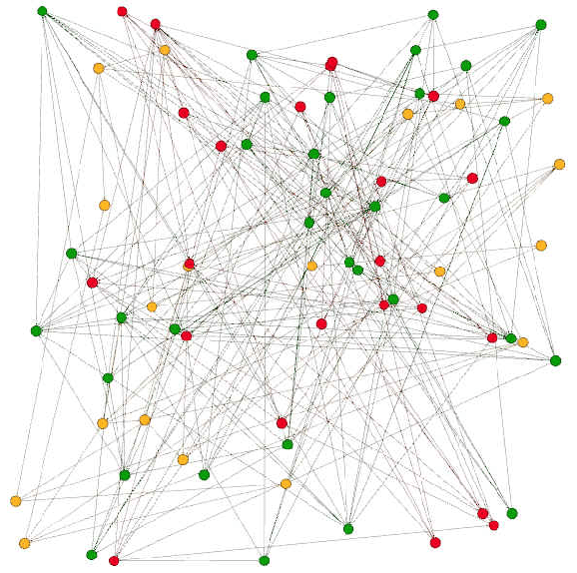
ERM Risks
“A complex network or interconnected system”
How many risks do we manage?
25 risks?
200 risks?
600 risks?
Who is involved in these risks?
How do we identify and assess these risks?

Slide 7
ERM Risks
Why define an ERM Ecosystem?
Reduce the complexity
Improve understanding
Improve adoption
Improve manageability
Improve “risk information”

Slide 8
Question for the Group
Which benefit of an ERM Ecosystem is most important to you?
Reduce the complexity
Improve understanding
Improve adoption
Improve manageability
Improve “risk information”

Slide 9
Rochdale’s ERM Ecosystem
Enterprise Risk Management (ERM)
Strategic Risk
(Future, Emerging)
Operational Risk
(Process, Product, Project)
Regulatory Risk
(BSA, OFAC, Fair Lending, HMDA, etc.)
Business Risk
(Strategy Execution, Business)
Four levels of risk in the ERM Ecosystem.
Credit Union Value:
Value Creation
Value Preservation
Value Realization
Value Creation
Value Preservation
Notes:
Value (From COSO)
Credit Union Value is created when strategies are achieved, and goals are met or exceeded.
Credit Union Value is preserved when day-to-day operations sustain the created value.
Credit Union Value is realized when our Members derive benefit from the credit union

Slide 10
Rochdale’s ERM Ecosystem
Enterprise Risk Management (ERM)
Primary Objectives & Key Questions
Strategic Risk
(Future, Emerging)
Operational Risk
(Process, Product, Project)
Regulatory Risk
(BSA, OFAC, Fair Lending, HMDA, etc.)
Business Risk
(Strategy Execution, Business)
Strategic Risk: Inform executive leaders and the Board to support strategic decisions that allow for the achievement of the mission and vision in a manner that optimizes the risk-to-return ratio of the credit union and its members.
Key Question: What will make us irrelevant in the future, and how risky is our strategy?
Who’s Involved?: The board and executive management.
Value Creation
Value Preservation
Notes:
Here we are talking about risks related to the strategy. RISK OF THE STRATEGY. From a risk perspective, this is future oriented or deals with emerging risk.
How risky is our strategy as it relates to the future or emerging risk?
Is our strategic plan forcing the credit union to take on a lot of risk, or is the plan very low risk? Which is right?
Are we taking the right risks to achieve the mission and vision?
Should we open more branches? Close branches? Merge or acquire? Pursue financial technologies that are proven, or maybe cutting edge? Should we change our name and rebrand?
How should we address climate change? How are we addressing ESG (Environmental, Social, and Governance)?
This is the realm of strategic risk management.

Slide 11
Rochdale’s ERM Ecosystem
Enterprise Risk Management (ERM)
Primary Objectives & Key Questions
Strategic Risk
(Future, Emerging)
Operational Risk
(Process, Product, Project)
Regulatory Risk
(BSA, OFAC, Fair Lending, HMDA, etc.)
Business Risk
(Strategy Execution, Business)
Business Risk: Increase the likelihood and reduce the variance of disruption in achieving strategic goals and department objectives in a manner that optimizes the expenditure of resources.
Key Question: What will keep us from hitting our strategic objectives, suffering losses, and degrading our brand?
Who’s Involved: Vice Presidents, Functional Heads, Business Unit Leaders, Internal Audit, Supervisory Committee.
Value Creation
Value Preservation
Notes:
Business risk is where the strategy gets executed…by the functions, departments and business lines.
Here we talk about RISK TO THE STRATEGY. What risks will keep us from achieving our goals and strategic objectives?

Slide 12
Rochdale’s ERM Ecosystem
Enterprise Risk Management (ERM)
Primary Objectives & Key Questions
Strategic Risk
(Future, Emerging)
Operational Risk
(Process, Product, Project)
Regulatory Risk
(BSA, OFAC, Fair Lending, HMDA, etc.)
Business Risk
(Strategy Execution, Business)
Operational Risk: Strengthen operational integrity and resilience in how the organization conducts its business to minimize critical failure points.
Key Question: What operational disruptions will cause us to lose time, money, and member trust?
Who’s Involved?: Managers, Process owners, Product owners, Internal & External Audit, Regulators.
Value Creation
Value Preservation
Notes:
This is the land of many risks. This is where the work gets done day-in and day-out.
We want to minimize risk to disruption, quality output. We try to balance efficiency with quality. We build processes, backup processes, test procedures, contingency plans, etc.
This is Value Preservation.
Internal Audit is involved here.

Slide 13
Rochdale’s ERM Ecosystem
Enterprise Risk Management (ERM)
Primary Objectives & Key Questions
Strategic Risk
(Future, Emerging)
Operational Risk
(Process, Product, Project)
Regulatory Risk
(BSA, OFAC, Fair Lending, HMDA, etc.)
Business Risk
(Strategy Execution, Business)
Regulatory Risk: Balance efforts to meet regulatory and legal requirements and the achievement of organizational goals to ensure that organizational values and legal obligations are met while allowing the organization, where possible, to take the necessary risk to meet its goals.
Key Question: What regulatory requirements will cause non-compliance, findings, and fines?
Who’s Involved?: Subject Matter Experts, Front line staff, Regulatory compliance owners, Internal & External Audit, Regulators.
Value Creation
Value Preservation
Notes:
Regulatory Risk is similar to Operational Risk, just more specific and sometimes more prescriptive.
Specific to regulations. And prescriptive in that the risk assessment process must cover certain things or be conducted in a certain way.
This is also Value Preservation.
And internal audit is involved here.

Slide 14
Rochdale’s ERM Ecosystem
Enterprise Risk Management (ERM)
Sources of Uncertainty
Strategic Risk
(Future, Emerging)
Operational Risk
(Process, Product, Project)
Regulatory Risk
(BSA, OFAC, Fair Lending, HMDA, etc.)
Business Risk
(Strategy Execution, Business)
Mostly External Uncertainties
Value Creation
Value Preservation
Mostly Internal Uncertainties
Notes:
One of the most fundamental aspects of “Risk” is the source of risk.
What causes the risk? We should be more interested in this than the risk event itself.
And although the consequence is the scary part, we focus on the source so we can avoid or minimize the consequence.
Here we see where the source of risk changes within the ecosystem.
At the strategic level the sources are primarily external, while at the operations and regulatory level, the sources are primarily internal.

Slide 15
Rochdale’s ERM Ecosystem
Enterprise Risk Management (ERM)
Risk Assessment Approach
Strategic Risk
(Future, Emerging)
Operational Risk
(Process, Product, Project)
Regulatory Risk
(BSA, OFAC, Fair Lending, HMDA, etc.)
Business Risk
(Strategy Execution, Business)
Scenario Analysis:
“What if?”
Value Creation
Value Preservation
Process and Controls Assessment: “Audit”
Notes:
How we assess risk differs across the ecosystem.
Risk identification is different.
At the Strategic Risk and Business Risk level, we ask a lot of “What if” questions. We leverage environmental scans and emerging risk processes.
At the Operational and Regulatory levels, we mostly have “Known” risks with controls in place. We assess the controls to ensure they are controlling risk as intended.
This is well understood by Internal Audit
This is not to say that we still always look for new risks and conduct risk identification exercises. Change in business context. Etc.

Slide 16
Rochdale’s ERM Ecosystem
Enterprise Risk Management (ERM)
Risk Programs
Strategic Risk
(Future, Emerging)
Operational Risk
(Process, Product, Project)
Regulatory Risk
(BSA, OFAC, Fair Lending, HMDA, etc.)
Business Risk
(Strategy Execution, Business)
Strategic Risk Management
Business Risk Management
Value Creation
Operational Risk Management
Value Preservation
Vendor Risk Management
Notes:
Risk programs within this overall ERM Ecosystem go by various names that align to their niche.
Strategic Risk Management, etc.
Vendor Management is a subset of Operational Risk Management.

Slide 17
Rochdale’s ERM Ecosystem
Enterprise Risk Management (ERM)
Business Processes
Strategic Risk
(Future, Emerging)
Operational Risk
(Process, Product, Project)
Regulatory Risk
(BSA, OFAC, Fair Lending, HMDA, etc.)
Business Risk
(Strategy Execution, Business)
Governance
Strategic oversight and planning
Business level planning and budgeting
Value Creation
Value Preservation
Operational execution
Control and compliance monitoring and assurance
Notes:
Business processes across the ecosystem also vary.
At the strategic level we have governance and strategic oversight and strategic planning.
At the business level we have a lot of planning and budgeting.
At the operational level we look at daily, weekly, monthly operational processes and how they are executed.
At the regulatory level we control for regulatory compliance via monitoring and audit.

Slide 18
Rochdale’s ERM Ecosystem
Enterprise Risk Management (ERM)
Business Outcomes
Strategic Risk
(Future, Emerging)
Operational Risk
(Process, Product, Project)
Regulatory Risk
(BSA, OFAC, Fair Lending, HMDA, etc.)
Business Risk
(Strategy Execution, Business)
Value Creation
Revenue
Profitability
Market share
Member value
Optimization
Capital efficiency
Resource allocation
Processes
Expense mgmt
Value Creation
Value Preservation
Value Preservation
Brand / Reputation
Reduced Variability
Compliance
Audit
Notes:
The credit union focuses on different business outcomes depending on where you are in the ecosystem.
Value creation is something the mission, vision, and strategy are out to achieve…for the members. This is where we look at revenue, profitability, etc.
Optimization is a goal at the business risk and operational risk levels both.
And again, value preservation is a goal of the operational and regulatory areas of risk.

Slide 19
ERM Risks
Why define an ERM Ecosystem?
Reduce the complexity
Improve understanding
Improve adoption
Improve manageability
Improve “risk information”

Slide 20
Conclusions
“Enterprise Risk Management” covers a lot of ground. It’s complex and interconnected.
Rochdale’s ERM Ecosystem breaks down the complexity so that it’s understandable, more fully adopted, and manageable.

Slide 21
Thank you.
Questions?
Contact me for more information:
David Seibert
DSeibert@RochdaleParagon.com
904-907-3510
or email Sales@ReimagineRisk.com

